Slide 1
MailBox
By khushbu joshi – fy6259

Slide 2
Mailbox features
Similar to the classic mailbox i.e. MS outlook and Gmail
User can -
Insert and delete mails.
Move a mail from one folder to another.
Count total mails
Count mails by folders

Slide 3
Mailbox features
User can also search mails by sender’s name.
If folder is selected, it only searches in that particular folder
User also can also search mails by specific text.
Sort mails by date-time
Ascending order
Descending order

Slide 4
Dataset features
Dataset Contains 5929 rows.
Each row contains 15 data field with 4 fields taking multi-valued attributes.
We mainly worked with all classic fields that are found in a mail box.

Slide 5
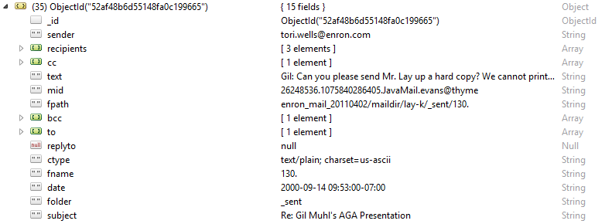
Dataset Description

Slide 6
CRUD Operations
User can add mails to system (CRUD - Create)
View the mails folder-wise (CRUD - Read )
Move mails from one folder to another(CRUD - Update)
Delete single/multiple mails (CRUD - Delete)

Slide 7
Map Reduce Queries
Count number of mails in the entire DB
Count number of mails contained in a particular folder (Parameterized query)
Takes folder name as parameter
Displays all the mails containing their subjects, number of recipients and recipient’s names for user chosen sender name (Parameterized query)
Takes sender name as parameter

Slide 8
Searching & sorting the mails
Searching
Search mails by sender name in a given folder
Search mails by text(i.e. if text matches with subject or message content) in a given folder
Sorting
Sort mails by date ascending
Sort mails by date descending

Slide 9
Technologies used
UI technologies
HTML-5, JSP, CSS3 (bootstrap.css), JavaScript, JQuery(1.7.2)
NoSQL DB
MongoDB
Back-end technologies – Business Logic
Java, Servlet
Web-server
Apache Tomcat 7.0
MongoDB Drivers (a.k.a used by java)
mongodb-driver-3.2.2.jar

Slide 10
Work distribution
Khushbu Joshi - fy6259(Front –end + Back-end)
Choose JSON Dataset
End-to-end GUI
Scripting
Database management
NOSQL queries
Complex Map-reduce queries
Testing and execution

